Slide 1
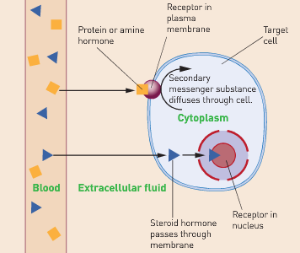
Hormone Action at the Cellular Level: Protein and Amine Hormones
Ch 2 HP

Slide 2

Date: | Human Biology Year 12 ATAR
Do Now Get out your equipment and textbook. Lesson Agenda 1: Do Now 2: Hormones – amine and steroid 3: Get started on review worksheet Suggested Study Complete review worksheet, then mark and correct using the answers on Connect. NEXT LESSON Past Exam Question Intro to the Hypothalamus and Pituitary | Learning Aims Describe how amine hormones function in the cell and give examples of amine hormones. Describe how steroid hormones function in the cell and give examples of steroid hormones Briefly describe enzyme amplification
 | Key Vocabulary Hormone Receptor Amine Steroid

Slide 3
Entry to target cells depends on hormone type
Some hormones are made from proteins, or protein components such as amines and peptides
Other hormones are made from steroids
Their chemical structure affects how they have their action on the target cell:
Steroid hormones can pass through the cell membrane as they are lipid soluble.
Protein/Amine hormones cannot pass through the cell membrane – they are water soluble.

Slide 4
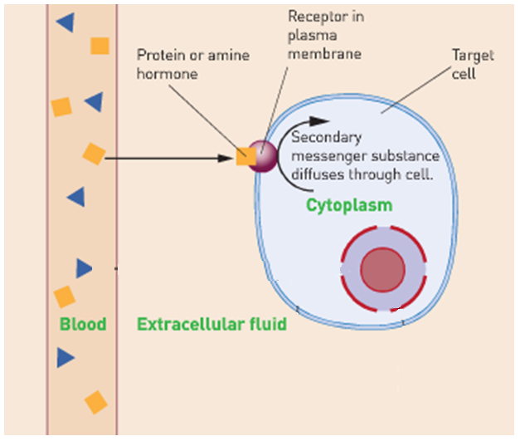
Protein / Amine / Peptide Hormones
These are water soluble, so they can’t pass through the cell membrane.
1: Hormone attaches to specific receptor on cell surface.
2: Hormone/receptor complex triggers release of a second messenger.
3: Second messenger diffuses through the cell and activates and amplifies enzymes that change cell functioning.
Note: the second messenger is broken down quickly, so duration of hormone action is shorter than for steroid hormones.
Learning Aim: Describe how protein/amine/peptide hormones function in the cell.

Slide 5

Enzyme amplification
For some hormones, each hormone molecule activates thousands of enzyme molecules
This is one way that a second messenger can work for protein and amine hormones
Occurs due to a process called enzyme amplification:
Hormone triggers a cascade of chemical reactions where the number of molecules involved increases exponentially at each step.
One hormone molecule can trigger
production of billions of enzyme molecules
Learning Aim: Briefly describe enzyme amplification

Slide 6
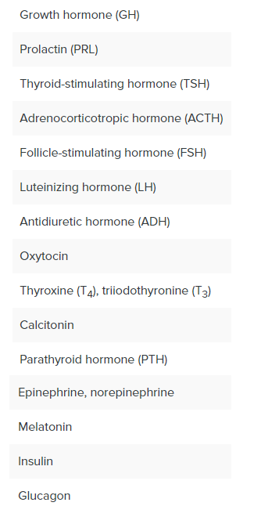
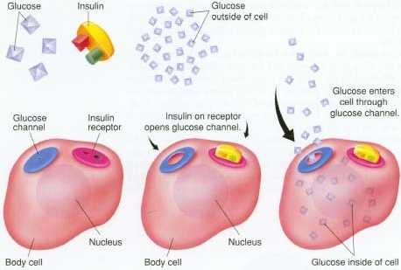
Protein and amine hormone examples
Other protein/amine hormone examples
Example: Insulin
produced by pancreas
enters bloodstream
unlocks cells so glucose can enter.
some tissues have more receptors than others
Learning Aim: Give examples of protein/amine/peptide hormones

Slide 7
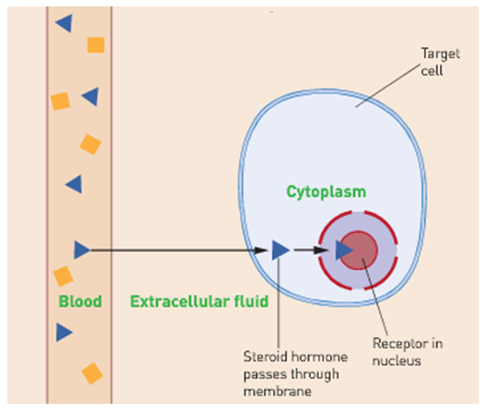
Steroid hormones
1: Hormone passes through cell membrane as they are lipid soluble.
2: Hormone binds to receptors inside cell.
Eg in nucleus, on mitochondria or other organelles
3: Hormone activates genes to change type, activities or quantity of protein produced:
May:
Activate genes to produce an enzyme or structural protein
Change shape of enzyme to turn it on or off
Change rate of transcription and translation to control rate of protein production
Hormone takes longer to clear, so duration of action is longer than for protein/amine hormones
Learning Aim: Describe how steroid hormones function in the cell.

Slide 8
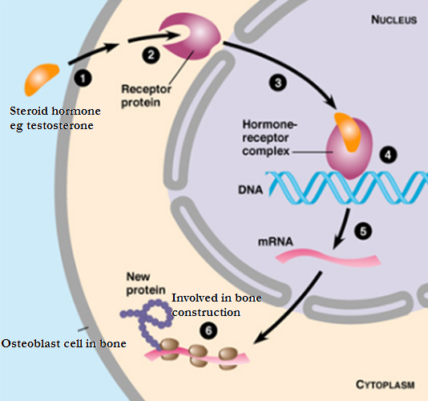
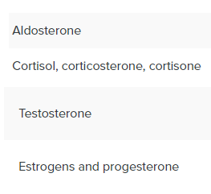
Steroid hormone examples
Eg: Testosterone
Testosterone passes through the cell membrane, and binds to a receptor protein within a bone cell, which then moves into the nucleus and activates genes which code for the production of proteins (eg collagen) involved in bone construction.
Note: testosterone has different effects in a number of different body cells.
Other steroid hormone examples:
Learning Aim: Give examples of steroid hormones

Slide 9
Comparing Protein/Amine and Steroid Hormones
 | Protein/Amine hormones |  | Steroid Hormones
Receptor site | On cell membrane |  | Inside cell on nucleus or organelles
Action of hormone/receptor complex | Activates second messenger substance |  | Hormone receptor complex moves to nucleus
Effect on cell | Second messenger activates enzymes |  | activates genes to change type, activities or quantity of protein produced
Duration of action | Shorter – second messenger broken down quickly. |  | Longer – hormone broken down more slowly
Examples | Thyroxine, Growth Hormone and many others |  | Testosterone, Oestrogen, Cortisol, and a few others

